Slide 1













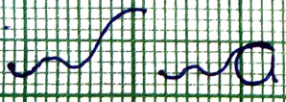



l
s
a
j
e
t
hoodi-l-2-l-t
Slant =
Top of curve =
Bottom of curve=
MZ Width =
MZ Height =
LZ Height =
UZ Height =
Curve type
Absolute baseline 1 =
Absolute baseline 2 =
Reference baseline =
s
n
x
d
21 ‘a’ pending

